Slide 1
Software Development Life Cycle & ALM Basics
Kovair Software Copyright © 2000-2014

Slide 2
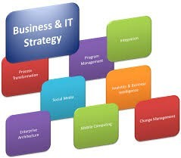
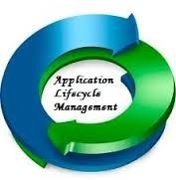
Business Strategy and IT
The importance of being different
A primary goal of business strategy is to create competitive advantage.
The essence of that advantage is having differentiation.
Virtually all business strategies today have an IT component.
And that IT component should have a
competitive advantage which in a product and service company depends on ALM.
WHAT IS ALM?
An Application Lifecycle is the supervision of
Software Application from initial planning to Retirement.

Slide 3
Three Aspects of ALM
Turning Business Ideas into Software
Governance
All decision making and project management
Development
Happens first between idea and deployment
Continually Reappears throughout an Application’s Life
Operations
Run and Manage the Application
•
•
•
Governance
Development Operations
Idea
Deployment
End of Life

Slide 4

Three Aspects of ALM
Governance Key to Maximizing Return
•
–
–
–
Start by Developing a Business Case
Manage Development with Project Portfolio Management
Manage the Application like any other business asset with Application Portfolio Management until End Of Life
Business Case Development
Project Portfolio Management
Application Portfolio Management

Slide 5
Three Aspects of ALM
Development
A fundamental part of every Application’s Lifecycle
•
Define Requirements based on the Business Case and Design, Develop and Test the Application
Manage Maintenance of the Deployed Application
Perform another development cycle to build a new version
•
SDLC is not ALM, but a part of the ALM story
SDLC, v1
SDLC, v2
Maintenance
Governance Development Operations

Slide 6
Three Aspects of ALM
Operations
Deployment needs to be intimately Connected with Development
•
–
–
A fundamental part of Operations
Planning for deployment begins before the application is completed, and the act of deployment itself is a fundamental part of operations.
•
Continuous Monitoring and Updates
Deploy
Monitor
Deploy Updates
Governance Development Operations

Slide 7

Absence of ALM –Missed Expectations
•
“We don’t have good visibility into project status”
“Our teams are not communicating effectively”
“Requirements are not sufficiently
defined or tracked”
“Software is not adequately tested”
“Cost of maintaining and operating the solution exceeds the business benefit”
•
•
•
•

Slide 8
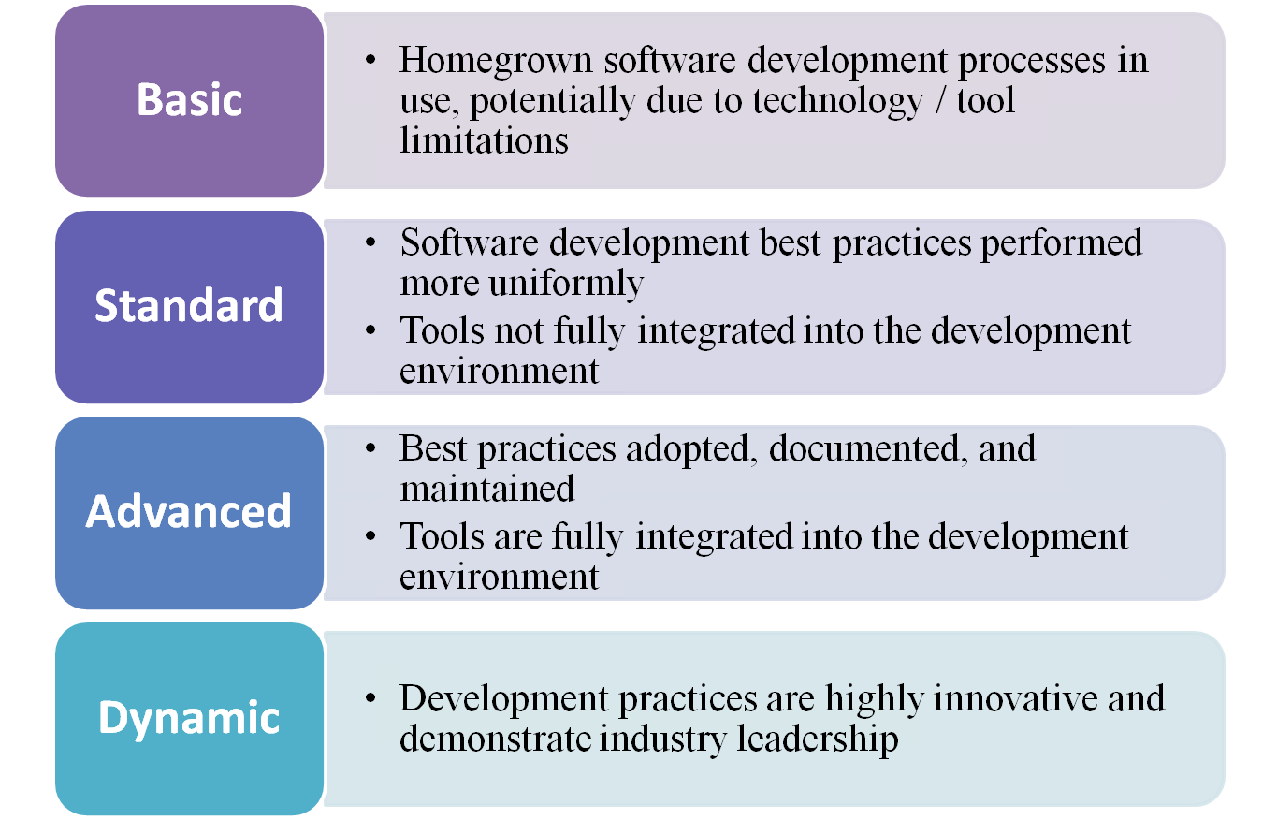
ALM Maturity Stages

Slide 9
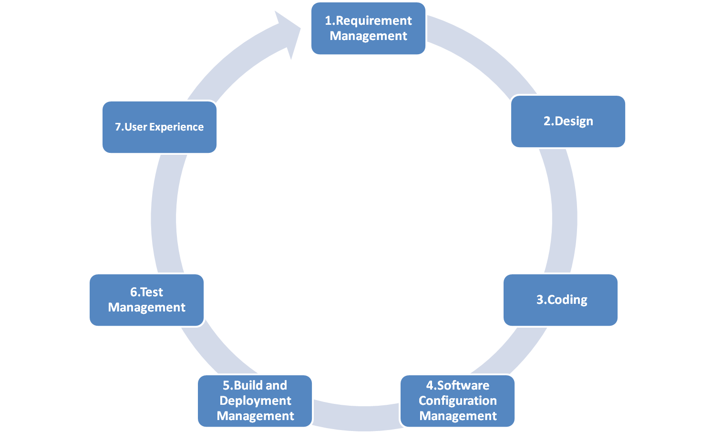
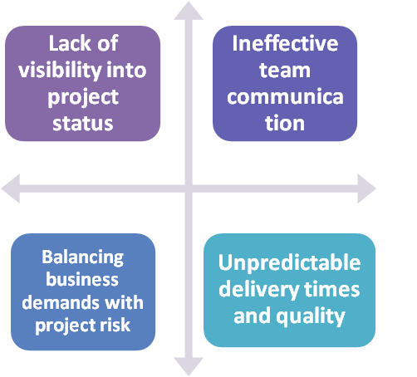
Typical Application Lifecycle Management Model
With ALM
With ALM
Without ALM

Slide 10
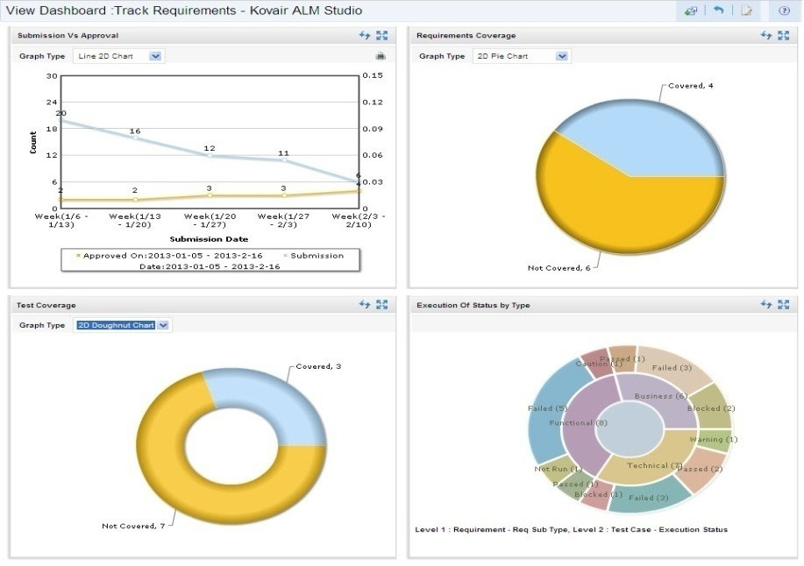
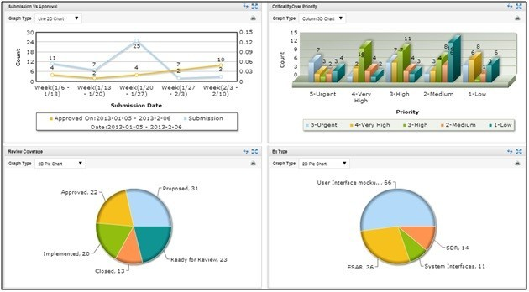
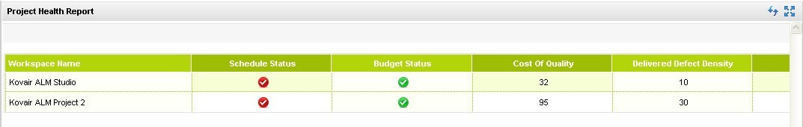
ALM Delivers Reports and Dashboards

Slide 11



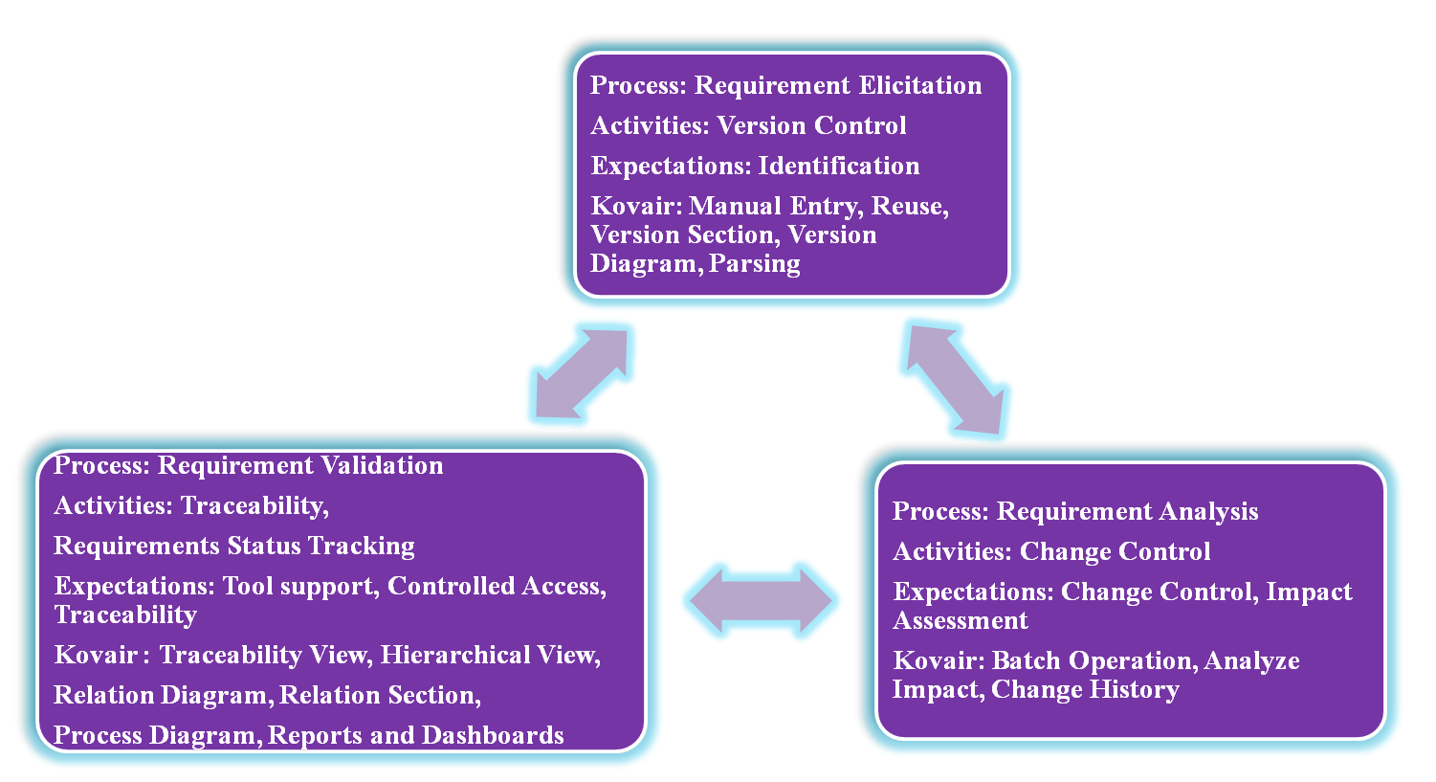

1.Requirement Management
Requirement management is the process of documenting, analyzing, tracing, prioritizing and agreeing on requirements and then controlling changes and communicating to relevant stakeholders. It is a continuous process throughout a project.
People
Process
Technology

Slide 12


Requirement Management Activities
Change Control
Version Control
Requirements Status Tracking
Traceability
•
Proposing changes
•
Defining a version identification scheme
•
Defining a possible requirement status
•
Analyzing impact
•
Defining links to other requirements
•
Making decisions
•
Identifying requirements document versions
•
Recording the status of each requirement
•
Updating requirements documents
•
Defining links to other system elements
•
Reporting the status distribution of all requirements
•
Identifying individual requirement versions
•
Update plans
•
Measuring requirements volatility

Slide 13

1.Requirement Management
Our Offerings in Requirement Management:
Online collaboration.
Unique identification.
Baseline.
Version Control.
Change Control.
Impact Analysis.
Status Tracking.
Traceability.
Different types of diagramming capability.
Capturing Requirements from different sources like :
Submission from a corporate website or portal.
Capturing from email sent to a configured and designated mail address.
Importing from Microsoft Office based documents such as Word and Excel.
Importing from a CSV file with configurable format.
Integrating with any third party Requirements Management tool through the Kovair Omnibus Integration Platform.
Synchronizing with any document management tools such as SharePoint.
13

Slide 14

2.Design
Design management is a business discipline that uses design and strategies to control a creative process.
People
Our Offerings in Design:
❖ Kovair integrates with the third party tools mentioned below.
Process
Technology
Integration with third party tools:
Enterprise Architect
Rational Software Architect/Rational Software Modeler Visual Studio
14

Slide 15
3.Coding
Code Management helps the developers to develop the code efficiently and keep track of version history of code modules.
People
Process
Our Offerings in Coding:
Kovair offers various options by integrating with the following tools.
Technology
Integration with third party tools:
Eclipse RAD
Visual Studio SonarQube JUnit

Slide 16
4.Configuration Management
In the Configuration Management System changes related to product specification and source code are managed.
Our Offerings in Configuration Management:
Kovair offers various options by integrating with the following tools.
❖
Integration with third party tools:
People
GIT
GitHub Gerrit Subversion
IBM RTC MS-TFS
ClearCase Perforce
Process
Technology
16

Slide 17
5.Build and Deployment Management
Build Management is often referred to as the process of converting source code files into standalone software component that can be run on a computer.
Our Offerings in Build and Deployment Management:
Kovair integrates with the third party tools mentioned below.
Integration with third party tools:
ANT
MS Build Hudson TeamCity
People
Process
Technology
17

Slide 18
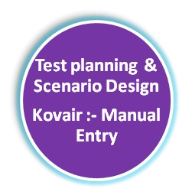



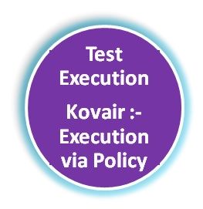
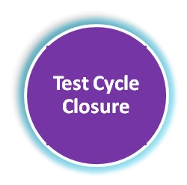




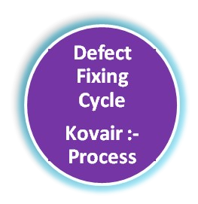

6.Test Management
Test management is a process where by software quality is validated. Test management offers the prospect of streamlining the testing process and allows quick access to data analysis, collaboration between the tools and easy communication across multiple project teams.
People
Test Case Development
Kovair : - Manual Entry , Reuse
Process
Technology
18

Slide 19
6.Test Management
Our Offerings in Test Management:
Manages both manual and automated tests
Version Control.
Automation of batch execution.
Automates defect capturing from failed Test Cases
Online Collaboration.
Status tracking.
Traceability.
Integration with third party tools:
IBM RFT IBM RQM IBM RTM HP QC
TestLink
VSTS 2010,2013
Selenium HP QTP
19

Slide 20
7.User Experience
User experience is the process of enhancing customer satisfaction and loyalty by improving the usability, ease of use, and pleasure provided in the interaction between the customer and the product. Kovair provides:
100% web based access.
No client side software.
Ease of configuration.
Graphical drag and drop workflow for process automation.
Ability to create unlimited workspaces.
Ease of creating business rules.
Consolidated reports and dashboards capability.
People
Process
Technology

Slide 21

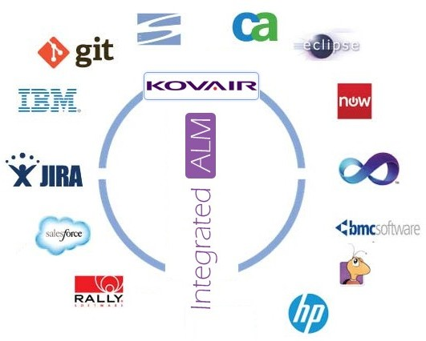
The Bus Concept for Integration
Integration is the ability to integrate multiple Application Lifecycle Management tools on the bus for the entire development & IT lifecycle. Kovair does this with its Omnibus technology.
Advantages of Omnibus Integration
Real-time bidirectional flow of data between tools
A database repository for analytics and reporting
Ability to define cross tool relations through plug-ins
End-to-end cross tool traceability
Support for both adapters and plug-ins as required for third party tools
Capability of conflict management
Support for data federation and synchronizatio
n

Slide 22
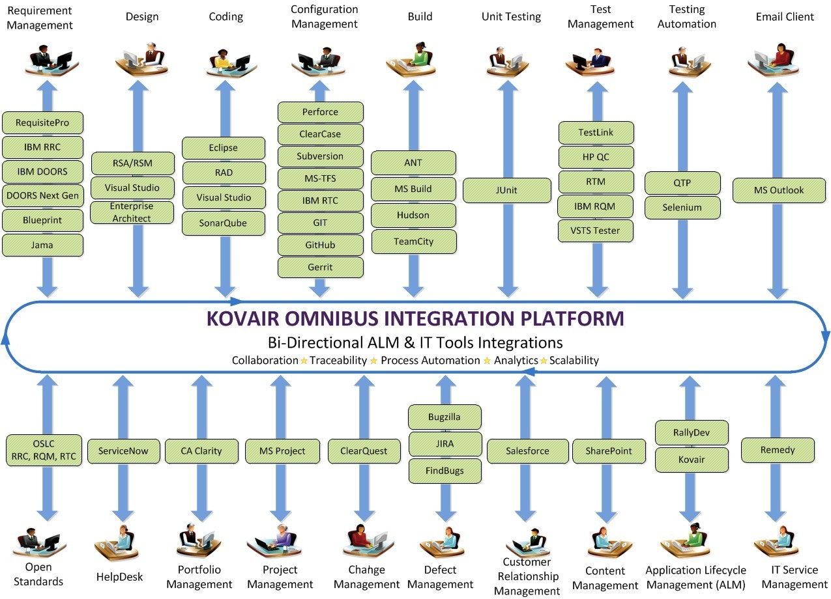
Omnibus Integration Bus – Off-the-shelf Integrations from Kovair ≈ 50
22

Slide 23
Conclusion
Application Lifecycle Management provides a rich and configurable global platform for implementing a software development life cycle process. KOVAIR provides you with the following:
High Level Architecture
100% web-based access
Process workflow automation
Codeless Configuration
Multiple Entities/workspaces
Entity Relations
Integration with third party tools
Traceability
Enterprise class Performance/Scalability
Entity Features
Multiple Input Methods
Security
Maintainability
Unified Data repository
Reporting and Dashboards

Slide 24
THANK YOU
For further queries please email us at :
sales@kovair.com Web: www.kovair.com

